Slide 1
Data Mining
Cluster Analysis: Advanced Concepts
and Algorithms
© Tan,Steinbach, Kumar Introduction to Data Mining 4/18/2004 <number>

Slide 2
More Clustering Methods
Prototype-based clustering
Density-based clustering
Graph-based clustering
Scalable Clustering

Slide 3
Prototype-based Clustering
Fuzzy c-means: objects are allowed to belong to more than one cluster
EM (Expectation-Maximization): a cluster is modeled as a statistical distribution
SOM (Self-Organizing Maps): clusters are constrained to have fixed relationships

Slide 4
Fuzzy c-means
A collection of fuzzy clusters is a subset of all possible fuzzy subsets of the set of data points.
  Each point is assigned a weight for each cluster. The sum of the weight for each point is 1.
  Each cluster contains at least one point but not all points.
Difference from K-means: instead of updating centroid and reassign points, c-means updates the centroid and the weight.

Slide 5
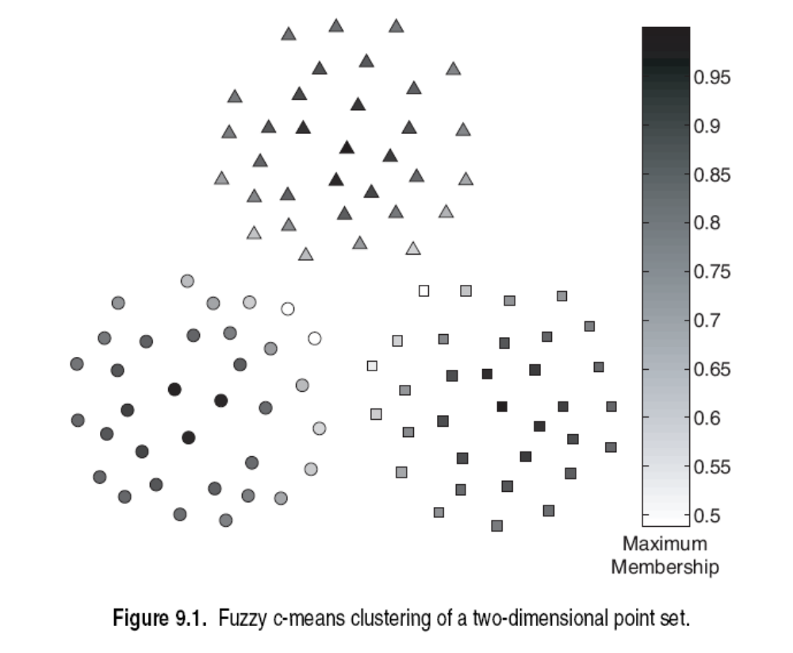

Slide 6
Clustering using Mixture Models
Mixture model: using statistical distributions to model data, with each distribution corresponds to a cluster
Maximum Likelihood principle:
  parameters for distribution are fixed but unknown
  best parameters are obtained by maximizing the probability of obtaining the samples observed

Slide 7
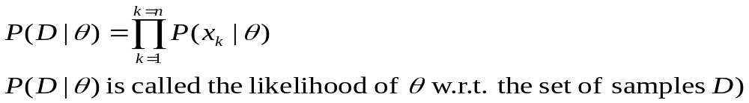

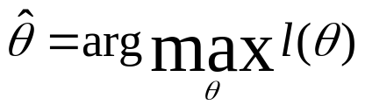
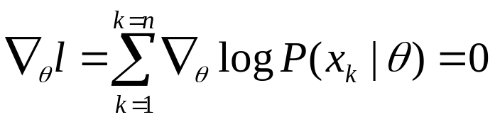
Likelihood Function:
likelihood function for a data set that contains n points:
log-likelihood function:
Distribution parameters that maximize the log-likelihood is given by:

Slide 8
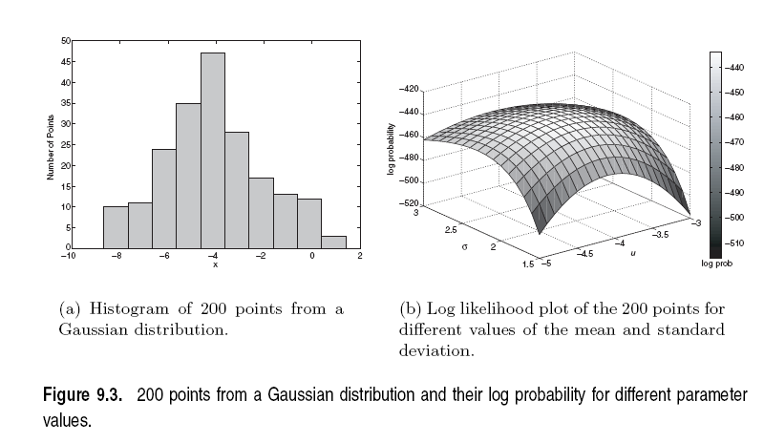

Slide 9
The EM Algorithm
Select an initial set of model parameters
Repeat
Expectation Step: for each object, calculate the probability
that each object belongs to each distribution
Maximization Step: Given the probabilities from the
expectation step, find the new estimates of the
parameters that maximize the expected likelihood
Until the parameters do not change
K-means is a special case of EM for Gaussian distributions with equal covariance but different means

Slide 10
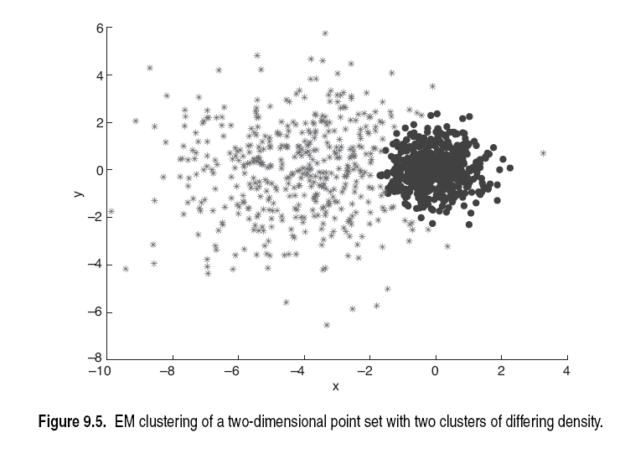
Left cluster corresponds to Gaussian distribution with center at (-4,1) and std=2
Right cluster corresponds to Gaussian distribution with center at (0,0), and std=0.5

Slide 11
SOM
Centroids have a pre-determined topographic ordering relationship
For each data point, its closest centroid and centroids in the neighborhood are updated
Output is a set of centroids with clusters implicitly defined.

Slide 12
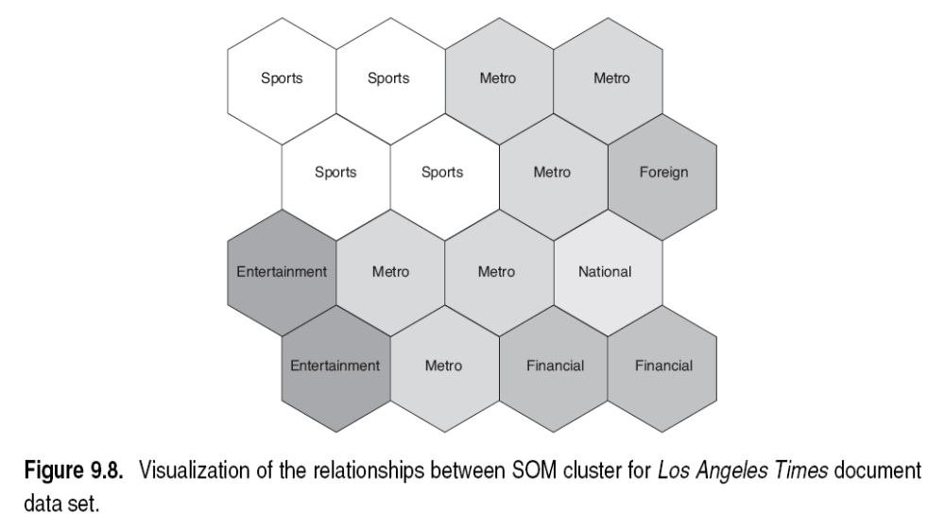

Slide 13
Density-based Clustering
Grid-based clustering:
  define a set of grid cells
  assign data points to the appropriate cells and compute the density of each cell
  eliminate cells with low density
  merge adjacent cells to form clusters
CLIQUE: cluster data points using a subset of attributes
DENCLUE: use kernel density function

Slide 14
Graph-based Clustering
Graph-Based clustering uses the proximity graph
  Start with the proximity matrix
  Consider each data point as a node in a graph
  Each edge between two nodes has a weight which is the proximity between the two data points
  In the simplest case, clusters are connected components in the graph
Graph-based clustering algorithms:
  Chameleon
  Shared Nearest Neighbor and SNN density

Slide 15
Chameleon
Adapt to the characteristics of the data set to find the natural clusters
Use a dynamic model to measure the similarity between clusters
  Main property is the relative closeness and relative inter-connectivity of the cluster
  Two clusters are combined if the resulting cluster shares certain properties with the constituent clusters
  The merging scheme preserves self-similarity
One of the areas of application is spatial data

Slide 16
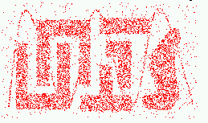
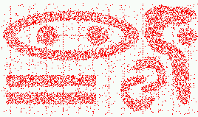
Characteristics of Spatial Data Sets
  Clusters are defined as densely populated regions of the space
  Clusters have arbitrary shapes, orientation, and non-uniform sizes
  Difference in densities across clusters and variation in density within clusters
  Existence of special artifacts (streaks) and noise
The clustering algorithm must address the above characteristics and also require minimal supervision.

Slide 17
Chameleon
Preprocessing Step:
Represent the Data by a Graph
  Given a set of points, construct the k-nearest-neighbor (k-NN) graph to capture the relationship between a point and its k nearest neighbors
  Concept of neighborhood is captured dynamically (even if region is sparse)
Phase 1: Use a multilevel graph partitioning algorithm on the graph to find a large number of clusters of well-connected vertices
  Each cluster should contain mostly points from one “true” cluster, i.e., is a sub-cluster of a “real” cluster

Slide 18
Chameleon
Phase 2: Use Hierarchical Agglomerative Clustering to merge sub-clusters
  Two clusters are combined if the resulting cluster shares certain properties with the constituent clusters
  Two key properties used to model cluster similarity:
    Relative Interconnectivity: Absolute interconnectivity of two clusters normalized by the internal connectivity of the clusters
    Relative Closeness: Absolute closeness of two clusters normalized by the internal closeness of the clusters

Slide 19
Shared Near Neighbor
SNN graph: the weight of an edge is the number of shared neighbors between vertices given that the vertices are connected
i
j
i
j
4

Slide 20
SNN Density Clustering
Compute the similarity matrix
This corresponds to a similarity graph with data points for nodes and edges whose weights are the similarities between data points
Sparsify the similarity matrix by keeping only the k most similar neighbors
This corresponds to only keeping the k strongest links of the similarity graph
Construct the shared nearest neighbor graph from the sparsified similarity matrix.
At this point, we could apply a similarity threshold and find the connected components to obtain the clusters (Jarvis-Patrick algorithm)
Find the SNN density of each Point.
Using a user specified parameters, Eps, find the number points that have an SNN similarity of Eps or greater to each point. This is the SNN density of the point

Slide 21
SNN Density Clustering
Find the core points
Using a user specified parameter, MinPts, find the core points, i.e., all points that have an SNN density greater than MinPts
Form clusters from the core points
If two core points are within a radius, Eps, of each other they are place in the same cluster
Discard all noise points
All non-core points that are not within a radius of Eps of a core point are discarded
Assign all non-noise, non-core points to clusters
This can be done by assigning such points to the nearest core point
(Note that steps 4-8 are DBSCAN)

Slide 22
Scalable Clustering Algorithms
Handles large amount of data
  BIRCH
  CURE

Slide 23

BIRCH
Balanced Iterative Reducing and Clustering using Hierarchies
Minimized I/O cost (1 or 2 scan)
Clustering Feature:
  N – number of points in a cluster
  LS – linear sum of points in a cluster
  SS – square sum of points in a cluster

Slide 24
CF-tree
Similar to B+-tree
Each node corresponds to one page
Parameters:
  B – branching factor
  T – threshold
Non-leaf node – contains at most B CF entries of its child
Leaf node –each entry’s diameter (or radius) has to be less than T, number of entries per node is determined by the page size and entry size.
  A leaf node represents a cluster made up of all the subclusters represented by its entries.

Slide 25
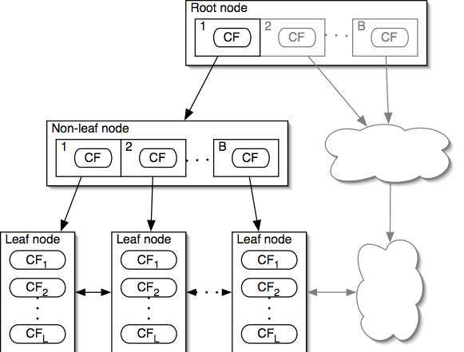
CF-tree

Slide 26
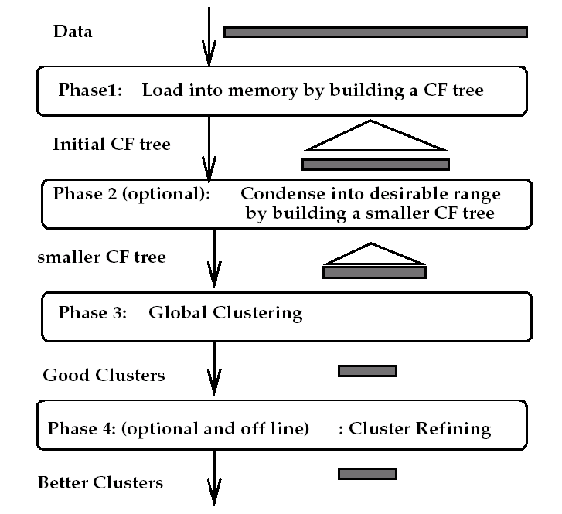
BIRCH Algorithm

Slide 27
BIRCH Algorithm
Phase 1:
  Start with initial threshold and insert points into the tree
  If run out of memory, increase threshold value, and rebuild a smaller tree by reinserting values from older tree and then other values
  Remove outliers while rebuilding tree
Phase 2:
  Optional – prepare the tree for Phase 3
  Removes outliers, and grouping clusters

Slide 28
BIRCH Algorithm
Phase 3:
  Cluster all leaf nodes on the CF values according to an existing algorithm (e.g. agglomerative hierarchical clustering)
Phase 4:
  Optional – refine clusters
  Perform additional passes over the dataset and reassign data points to the closest centroid
  Recalculate the centroids and redistributing the items.

Slide 29
An Example of the CF-tree
  Initially, the data points in one cluster.
root
A
A

Slide 30
An Example of the CF-tree
  The data arrives, and a check is made whether the size of the
  cluster does not exceed T.
root
A
T
A

Slide 31
An Example of the CF-tree
  If the cluster size grows
  too big, the cluster is split
  into two clusters,
  and the points
  are redistributed.
root
A
B
B
T
A

Slide 32
An Example of the CF-tree
  At each node of the tree,
  the CF tree keeps information about the mean of the
  cluster, and the mean
  of the sum of squares to
  compute the size of the
  clusters efficiently.
root
A
B
A
B

Slide 33
CURE
Uses a number of points to represent a cluster
Representative points are found by selecting a constant number of points from a cluster and then “shrinking” them toward the center of the cluster
Cluster similarity is the similarity of the closest pair of representative points from different clusters
×
×

Slide 34
CURE
Shrinking representative points toward the center helps avoid problems with noise and outliers
CURE is better able to handle clusters of arbitrary shapes and sizes

